Slide 1
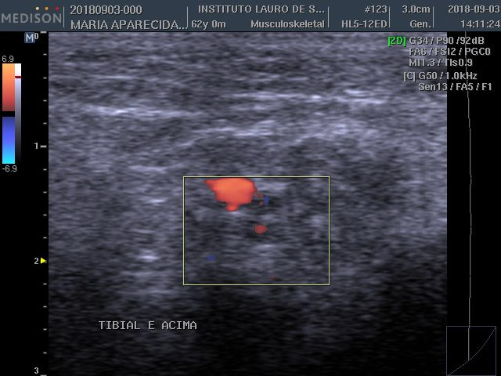
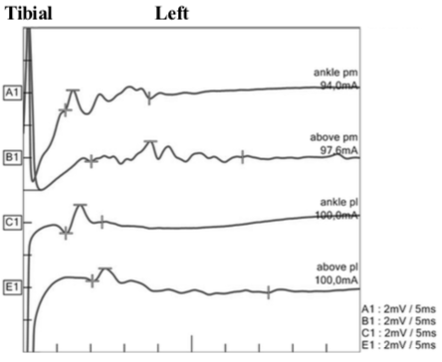
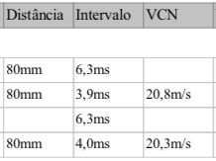
Neurophysiological and ultrasonographic study with doppler in leprosy neuropathy
Juliana Akita; Luiz Henrique Granja Miller; Flávia Moerbeck Casadei de Mello; Jaison Antonio Barreto; Ana Lucila Moreira; Daniel Rocco Kirchner; José Antonio Garbino
E-mail: akitajuliana@gmail.com
Instituto Lauro de Souza Lima - ILSL
Introduction
Mycobacterium leprae is the most treatable etiology of peripheral neuropathy in developing countries in tropical and subtropical areas. Although ultrasound has been used to evaluate peripheral nerves, only recently it has been used in leprosy neuropathy. In this disease, just few studies correlated ultrasonographic findings with nerve conduction (NC) changes. Even so, the attempt to correlate early ultrasound abnormalities with the color doppler as a marker of reactional episodes to the findings of inflammatory activity at nerve conduction, accepted in the literature, has not already been performed.
Figure 1. Left: Left tibial nerve, transverse acquisition, with central (arrow) and peripheral blood flow (arrowhead). On the right, nerve conduction study of the same nerve demonstrating temporal dispersion through the tarss.
Objective
Evaluate the peripheral nerves of leprosy patients with acute neuritis clinic, without corticosteroids treatment, by doppler ultrasonography and nerve conduction study.
1,5 %
Methods
31%
Patients with leprosy and clinical signs of acute neuritis were first evaluated with NC and then with doppler ultrasonography (US). The diagnosis of leprosy was previously established in a specialized outpatient clinic. The nerves evaluated were: ulnar, in segments at the elbow, forearm and distal third of the forearm; fibular, on the head of the fibula, 2 cm distal and popliteal region; median, in the wrist and in the antecubital and tibial fossa, in the tarsus and proximal to the medial malleolus). The following parameters were analyzed: nerve ecotexture, perineural edema and presence of peripheral and central flow at the doppler.
Table 1. Presence of blood flow to the doppler according to the type of electrophysiological alteration found in the nerve conduction study.
Comparison between ultrasound and electrophysiological findings
Electrophysiological change | Presence of blood flow | No Doppler Flow |  | Total
Focal demyelinating lesion (TD) | 5 (31%) | 11 |  | 16
Axonal injury | 3 (1,5%) | 17 |  | 20
Presence of blood flow | NC altered | Normal NC | Minimal changes in NC | Total
Central | 3 | 0 | 0 | 3
Periferic | 4 | 1 | 3 | 8
Results
Table 2. Prevalence of doppler flow in neurophysiological changes and nerve conduction changes in presence of doppler flow. (TD, temporal dispersion; NC, nerve condution; minimum changes, considered motor and / or sensory speed reduction).
In total, seven patients and 68 nerves were analyzed (29 ulnar, 20 fibular, eight median and 11 tibial). Sixteen nerves (23%) presented temporal dispersion. Of these, five (31%) had positive doppler flow (Figure 1), two of them with central flow. Seven (43%) had loss of ecotexture pattern and 10 (62%) had perineural edema. Twenty nerves (29%) presented with axonal lesions, of which three (1.5%) had positive doppler flow, all of them with central flow (Table 1). Seven (35%) had loss of ecotexture pattern, and 10 (50%) had perineural edema. Four nerves presented positive doppler flow without significant changes in nerve conduction (temporal dispersion or axonal injury), three of them had minimal changes (reductions in motor or sensory conduction velocities). Only one had normal nerve conduction, with ecotexture alteration and perineural edema (Table 2).
Conclusion
The doppler study with increased peripheral vascularization at the nerve and at the center of the trunk was more frequently present (31%) in cases with segmental demyelination, that is, a characteristic finding of inflammatory neuropathy. In the nerves with axonal injury to NC, the US with doppler was less positive (1.5%), presumed to be a older injury and without recent inflammatory activity. With normal NC, the doppler was positive at only one nerve. This study suggests that the sonographic study can aid in the diagnosis of inflammatory neuropathy in the nerves where NC is not characteristic.

