Slide 1



Course 1.1: Neuromuscular Aspects of Tropical Diseases
Major Neuromuscular and Neurophysiological Aspects of Hansen’s Disease
Garbino – Instituto Lauro de Souza Lima – Bauru/ SP/ Brasil

Slide 2
Declaration of Conflict of interest
There is no conflict of interest in this presentation
José Antonio Garbino

Slide 3
“NEGLECTED DISEASES” - WHO
TDR Programm for Research and Training in Tropical Diseases
  Bacterial infections
  Bartonella
  Bovine Tuberculosis in Humans
  Buruli Ulcer
  Cholera
  Enteric pathogens
  (Shigella, Salmonella, E. coli)
  Leprosy
  Leptospirosis
  Relapsing Fever
  Trachoma
  Treponematoses (Bejel,Pinta,
  Syphilis, Yaws)
  Fungal Infections
  Mycetoma
  Paracoccidiomycosis
  Ectoparasitic Infections
  Scabies
  Myiasis
  PLoS Negleted Tropical Diseases

Slide 4
Summary
  Neuropatology and Diagnosis
  Primary neural leprosy (PNL)
  Inflammatory Neuropathy: Leprosy Reactions
  Entrapments in leprosy
  Follow-up during disease progression
  Nerve Histopathology in PNL byopsies
VITAL RT et al. Progression of Leprosy Neuropathy: a case series study. Brain and Behavior 2(3), 2012
LUGÃO HB et al. Ultrasonography of Leprosy Neuropathy: A Longitudinal Prospective Study. PLoS Negl Trop Dis 10(11): 2016
TOMASELLI PJ et al. Primary neural leprosy: clinical, neurophysiological and pathological presentation and progression. Brain, 2021

Slide 5
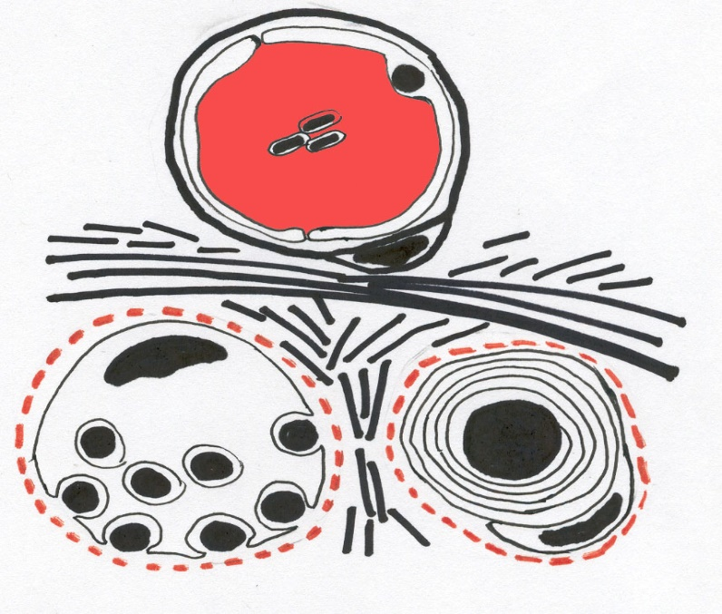
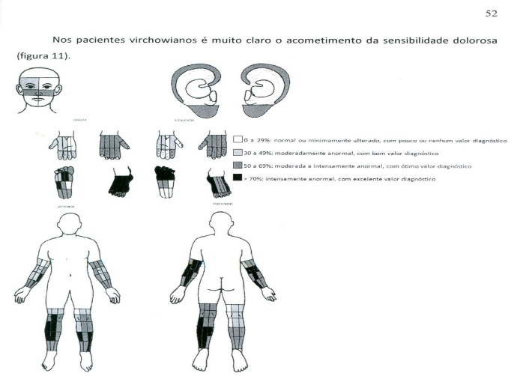
How the M Leprae (intra cell parasite) spread to the peripheral nervous system
Monocites
SC“trunk cell like” release ML to stromal cells
Pain > Thermal > Tactile sensation
Dos Santos CBA. FMRP-USP; 2010
M.leprae + Laminina α 2G (Basal lamina) α-Dystroglycan + (Cell Membrane)
RAMBUKHABA et al. Science, 1998, 2002

Slide 6
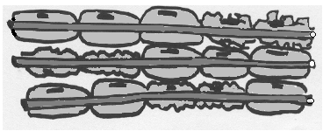
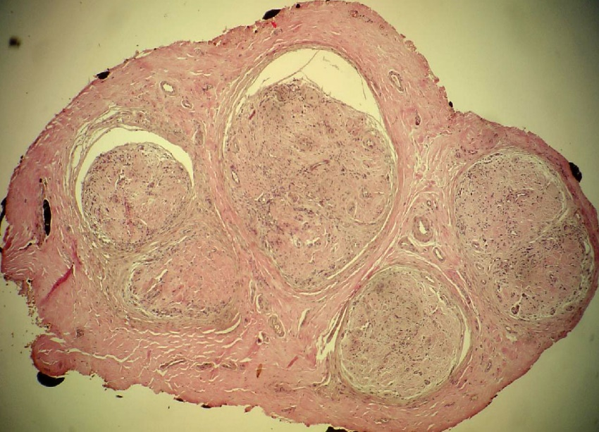
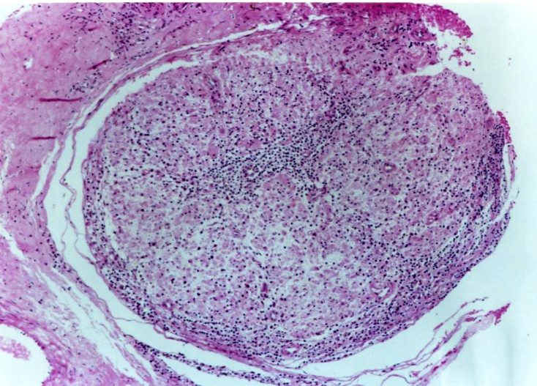
LEPROSY NEUROPATHY “Progression”
Inflammatory
Axonal loss
Demyelination
Reactions
Vascularization; edema + entrapments
exuberant symptoms
recurrent 4- 5 years
ML parasitizes the SC
little or no symptoms
5 -10 years
Interstitial fibrosis
little or no symptoms
(JARDIM MR et al, J Neurol, 2003; GARBINO JA et al. 2004)
“a marked difference in clinical phenotype between patients with short and long disease duration”, TOMASELLI et all.2021

Slide 7
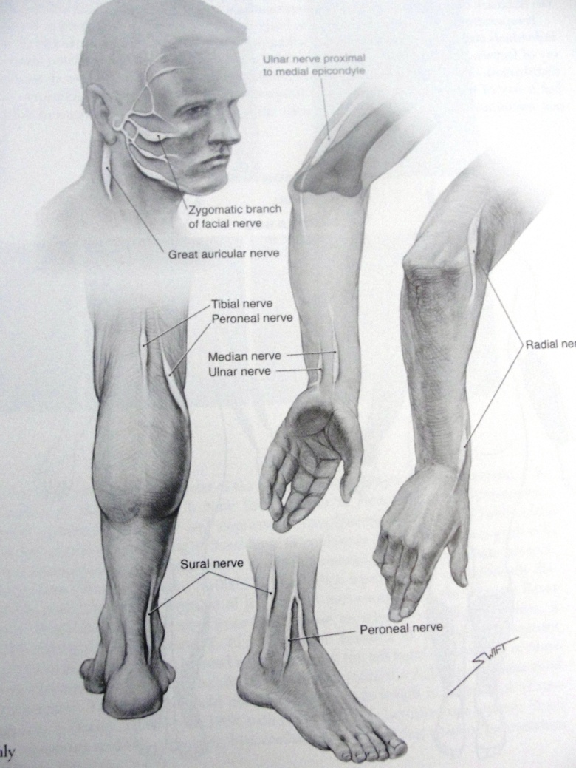
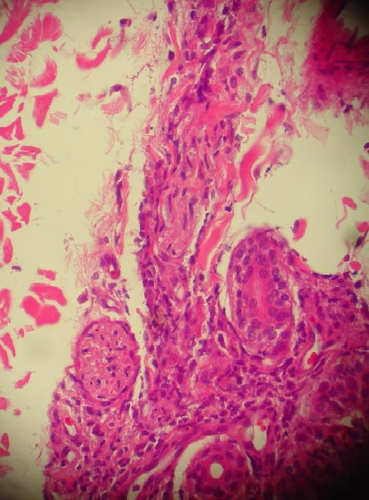
Diagnosis
Three dermatological cardinal signs: (high sensitivity and specificity)
  Hipo or anestethic skin lesions
  Enlarged nerves
  Positive skin smear
Indeterminate leprosy (intradermal nerve injury):
  skin smear and skin biopsy and PCR for ML
    (PCR: protein chain reaction)
Primary Neural Leprosy (PNL)
  Mononeuropathy or multiple mononeuropathy: Nerve conduction studies (NCS), Ultrasound (US), nerve histopathology and PCR for ML
Sabin TD et al. 2005
Garbino. Hansen Int, 1998
Notes:
has high sensitivity and specificity, errors arise when they are not correctly identified due to incomplete, inadequate or superficial clinical examination.

Slide 8
Multiple Mononeuropathy
De Faria called “mosaic” distribution¹
Hand digital branches: Sensory Multiple Mononeuropathy
(1,2)
“Mosaic” distribution is appropriate to pain and tactile sensory testing mapping³
(3)
De Faria CR, Silva IM. Electromyographic diagnosis of leprosy. Arq. NeuroPsiquiatr, 1990
Vital RT et al. Isolated median neuropathy as the first symptom of leprosy. Muscle Nerve. 2013
Dos Santos CBA. Estudo da distribuição da perda sensitiva na hanseníase. [dissertação]. FMRP-USP; 2010.

Slide 9
SUDOMOTOR C FIBERS ENVOLVEMENT - dysautonomy
The neurophysiologic finding is relatively late, avarege time of 7 years (∆ 2-9 years), contrasting of C fibers for pain sensory

Slide 10
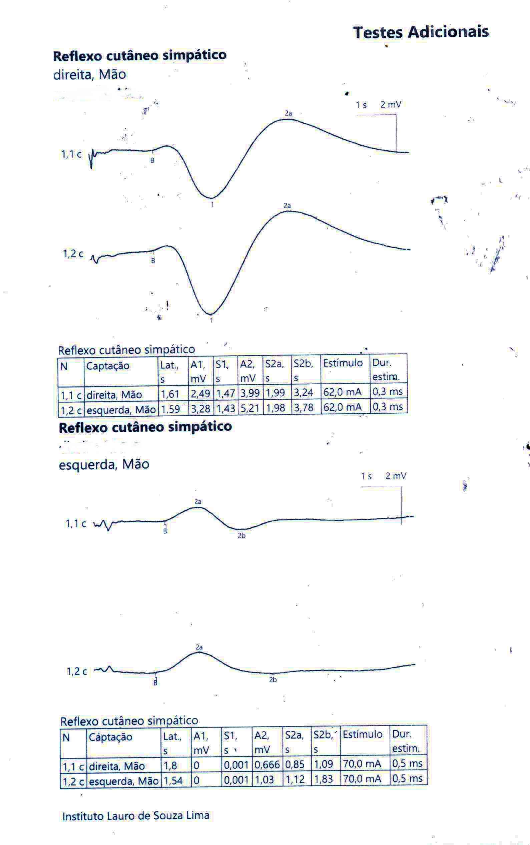
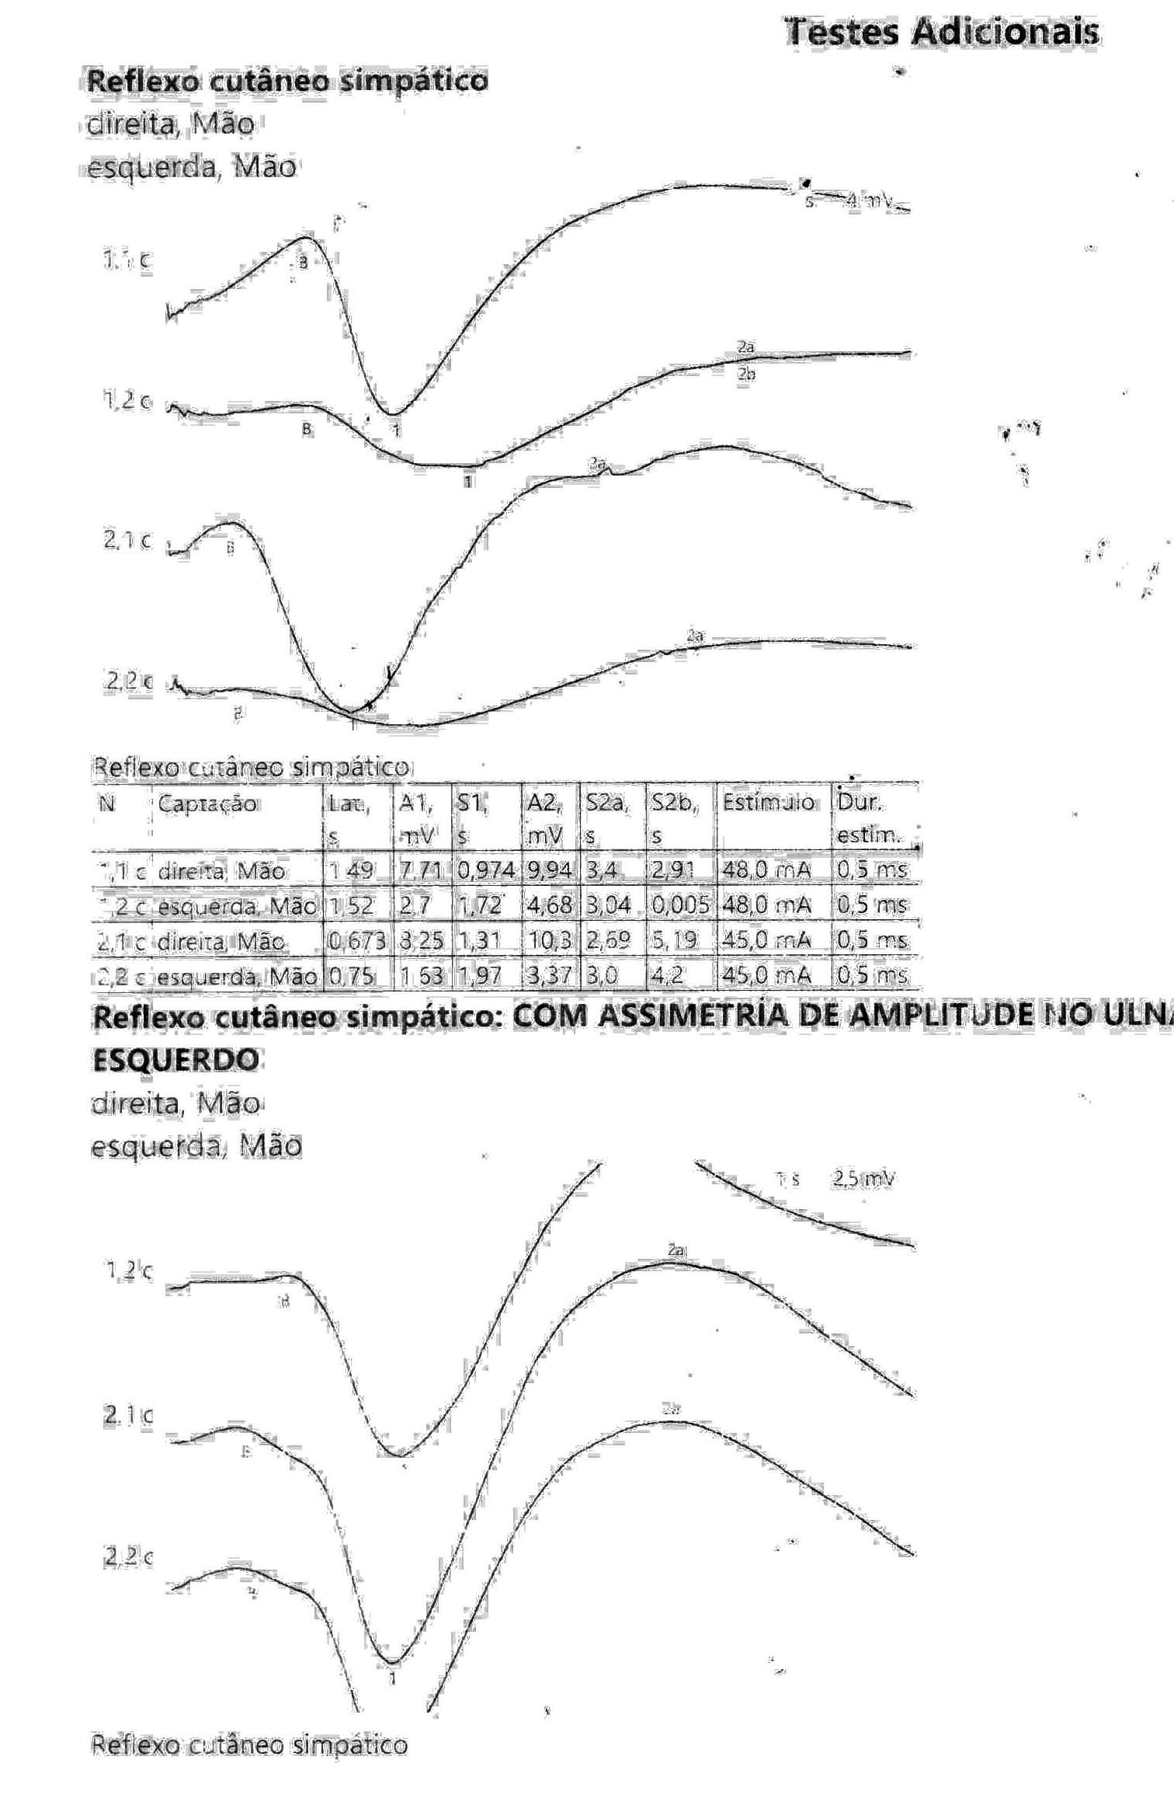
Sympathetic Skin Response: Upper limbs
Registered in Median nerve Right and Left
Right hand, Median and Ulnar, reduced response in Ulnar side
Registered in Ulnar nerve Right and Left
Normal responses in both nerves in the left side
Normal subject, UPPER LIMBS
A patient with Right Ulnar palsy, assimetric responses, reduce and long in rightUlnar nerve

Slide 11
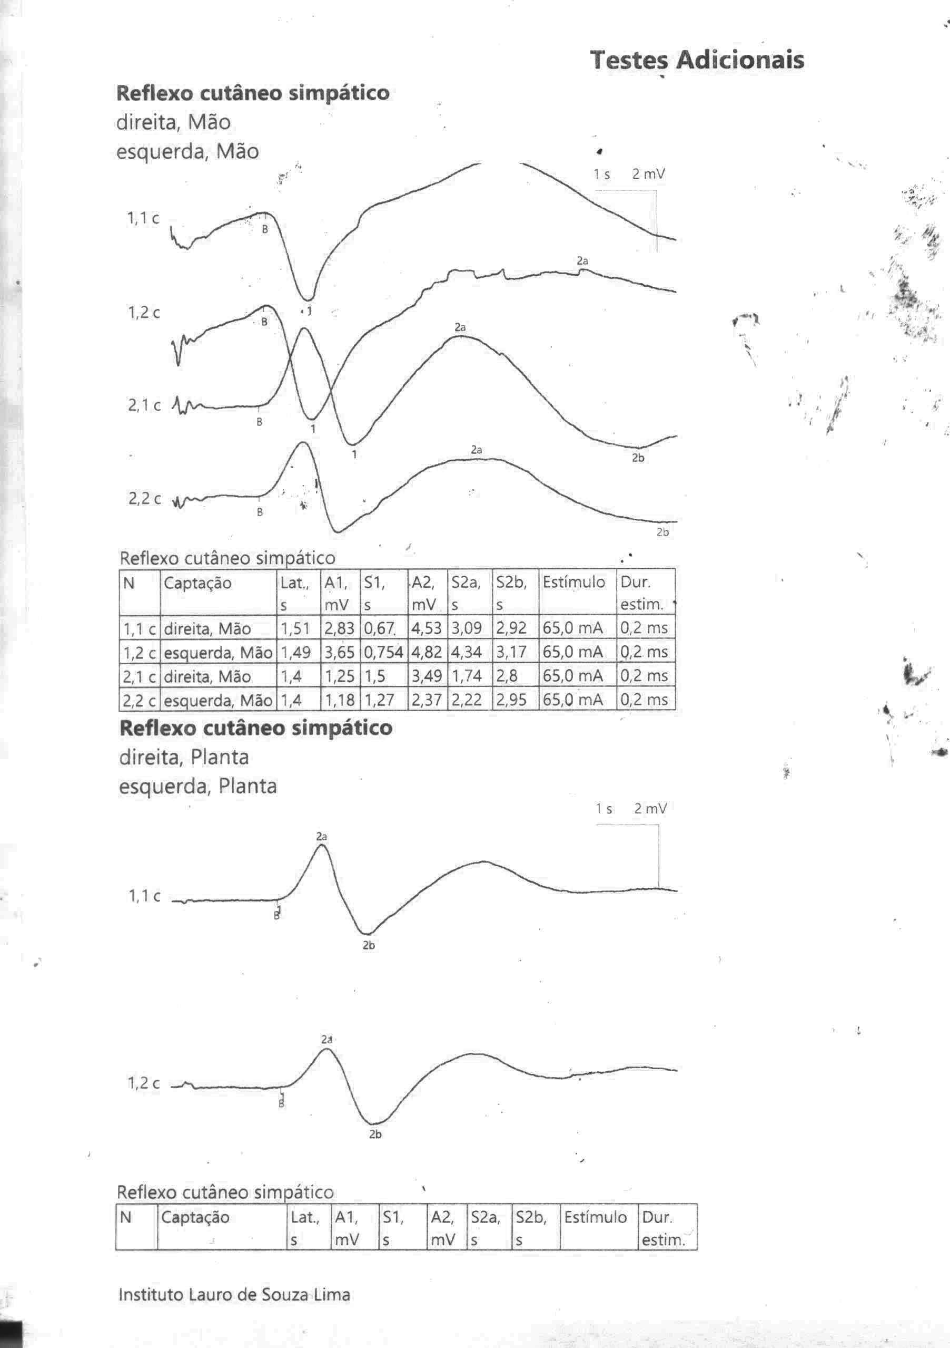
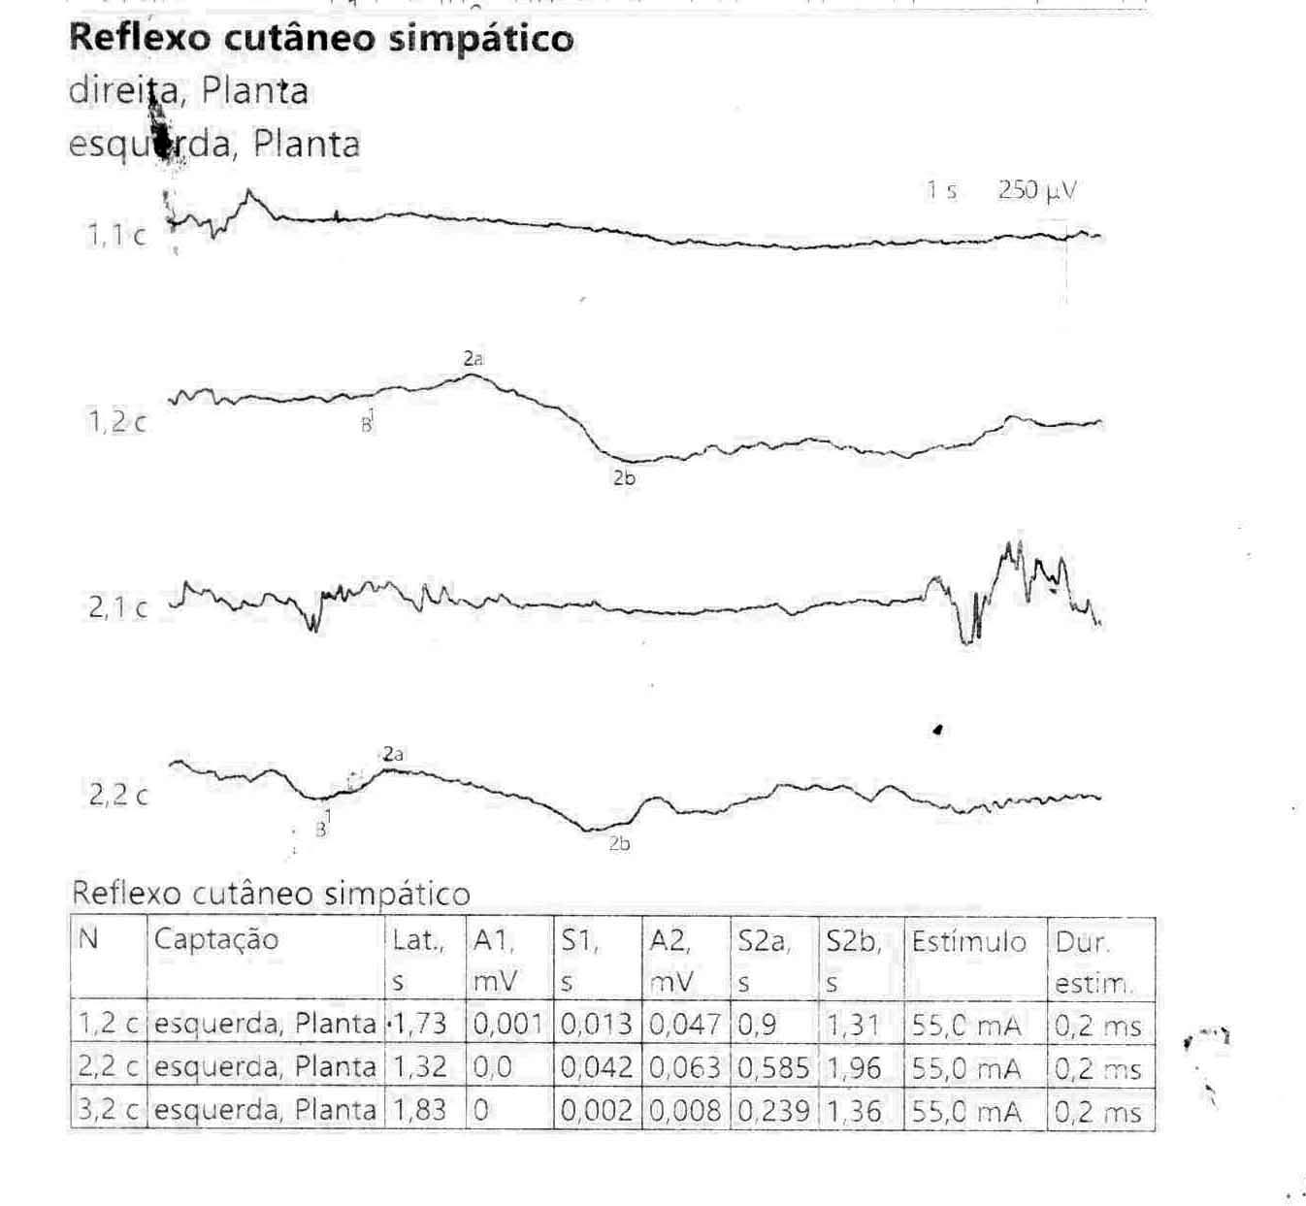
Sympathetic Skin Response: Lower limbs
Registered in UL, Median and Ulnar, Right and Left
Registered in the sole R and L, 2X
Registered in the sole Right and Left
A patient , LOWER LIMBS, absent in the Right side and reduced and alonged in the Left side
Normal subject, UPPER and LOWER LIMBS

Slide 12
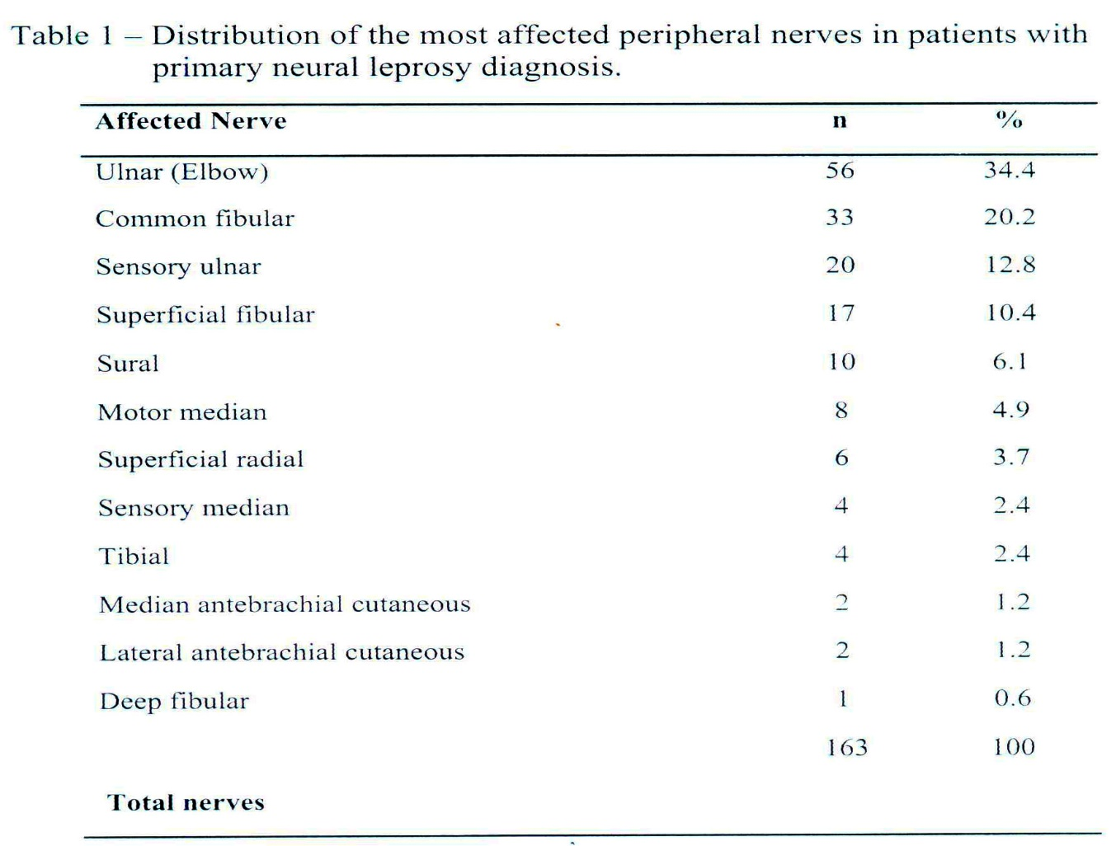
More affected nerves in PNL (“universal” involvement of fibers)
Dos Santos, DF et al. 2017

Slide 13
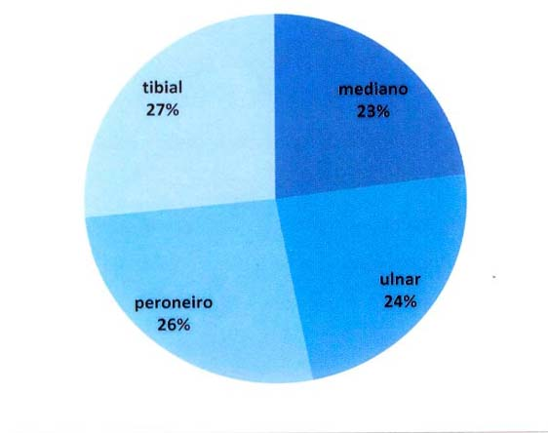
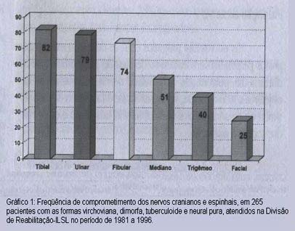
Mixed nerve trunk distribution in patients recently and long term examined - PROGRESSION
NCS: Marques, VD. FMRP-USP; 2017
Sensory mapping and VMT: Garbino JA. ILSL. 2000
In the Long Term follow-up the cranial neuropathies are seen, Trigeminal and Facial

Slide 14
NEUROPHYSIOLOGIC PATTERNS DESCRIBED BY BRAZILIAN AUTHORS
Assimetric sensory and motor neuropathy (Multiple mononeuropathy)^{1,2}
Assimetric sensory and motor neuropathy with focal reduction of CV (Multiple mononeuropathy)^{2,3}
Sensory multiple mononeuropathy¹
demyelinating mononeuropathy³
sensory axonal mononeuropathy^{3,4}
Subacute demyelinating Inflammatory neuropathy (TD)^{5,6}
1. DE FARIA CR, SILVa IM. Arq. NeuroPsiquiatr, 1990; 2. JARDIM MR et al. Journal of Neurology. 2003; 3. DOS SANTOS, DF et al.. PLOS Neglected Tropical Diseases, 2017; 4. VITAL RT et al. Muscle Nerve. 2013; 5. GARBINO JA et al. Leprosy Review , 2010; 6. ROBLES MM, BALDISSEROTO CM and GARBINO JA. Hansenologia Internationalis: Hanseníase e outras doenças infecciosas, 2012.

Slide 15
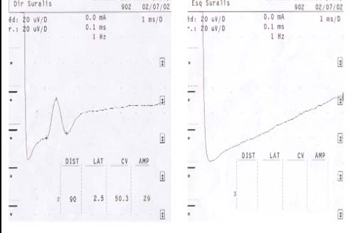
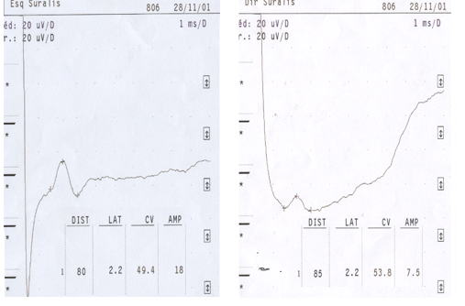
Sensory Assimetric Neuropathy
(Warning: greater number of nerves examineds more sensible is the results)
Left Sural nerve without response
Right Sural with amplitude reduction > 50%
GARBINO JA, MARQUES W Jr, BARRETO JA et al, Primary neural leprosy: systematic review. Arquivos de neuro-psiquiatria 71 (6), 2013

Slide 16
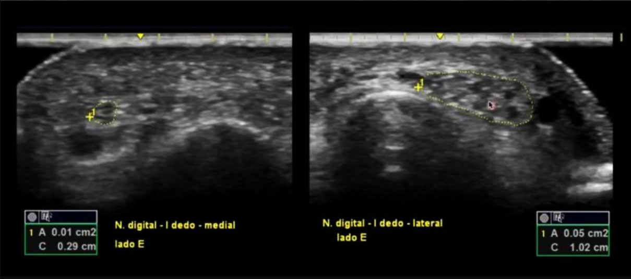
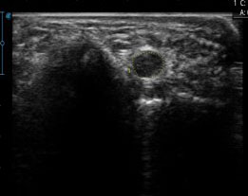
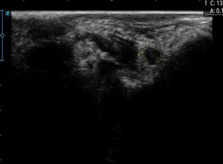
Focal and assimetricaly enlarged nerve on US
Enlarged digital nerve 5X > on the lateral side
Left Ulnar: 0,20 cm²
Without vascularization
Right Ulnar: 0,10 cm²
  (Warning: enlarged nerves identified by the US can be find in: Charcot–Marie–Tooth, HNPP, FAP, CIDP, Guillain-Barré, Multifocal Motor Neuropathy, Motor and Sensory Multifocal Neuropathy, Neurofibromatosis, and nerve tumor (GOEDEE HS et al. European Journal of Neurology. 2013)

Slide 17
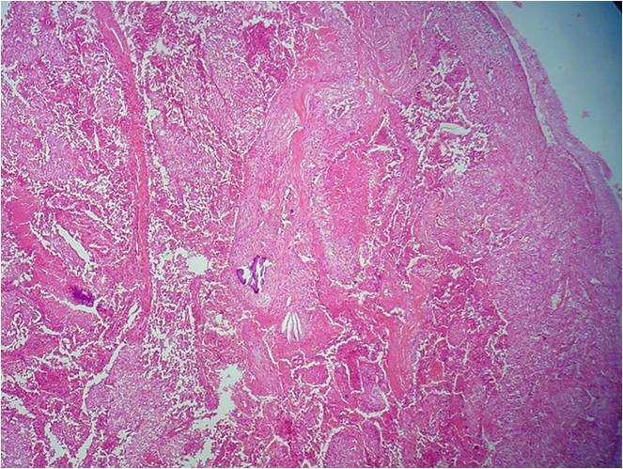
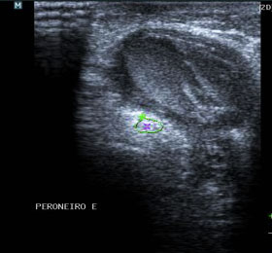
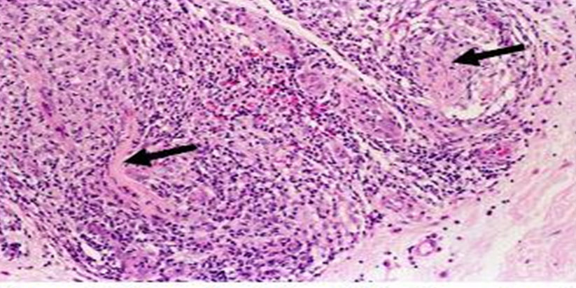
Nodule in nerve: Tuberculoid mononeuropathy x tumor
Malignant epithelioid Schwannoma destroying nerve structure
Tubeculoid granulomas destroying nerve structure
US image, the differential is the histopatology →
ALMEIDA JEM, KIRCHNER DR, CURRY MFo, SOARES CT a GARBINO JA. Peripheral nerve tumor, a differential diagnosis with primary neural leprosy: five case reports. Hansenol Int, 2020.

Slide 18
inflammatory neuropathy Leprosy reactions acute/subacute and recurrent

Slide 19
Nerve inflammation spectrum - Neuritis: depends on the individual immunity
Paucibacilary: tuberculoid (T, BT) → Multibacilary: (BB, BL and L)
One nerve mononeuropathy → + nerves multiple
Reactions:
  Tipo 1 BB to BL (6 m) reversal reaction
  celular immunity
  Tipo 2 BL and LL (1 m) erythema nodosum > recurrences
  > humoral immunity
If it lasts more than 4 years: relapse, bacilli resistence or reinfection
BT: borderleine tuberculoid
BB: borderleine borderleine
BL: borderleine lepromatous
L: lepromatous
GARBINO JA, HEISE CO, MARQUES Jr W. Assessing nerves in leprosy, Clinics in Dermatology (2016).

Slide 20

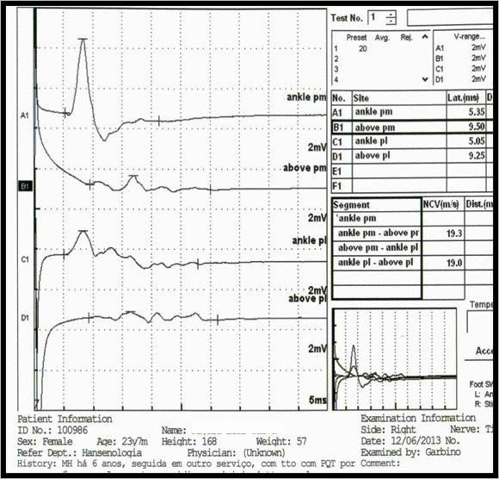
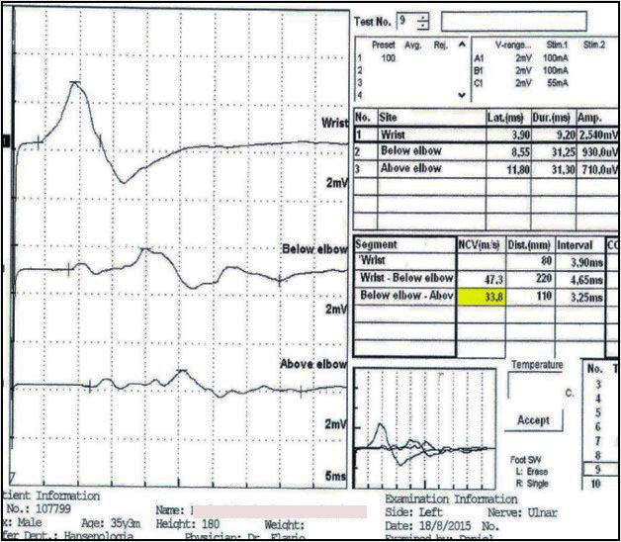
Neurophysiologic pattern during reactions: intense demyelination
M wave (coumpound motor action potential) NORMAL
M wave: decomposed CMAP
(temporal dispersion, TD)
TIBIAL (P MEDIAL e LATERAL): Robinson et al. Hansen Int. 2015
ULNAR: Garbino et al. Lep Rev, 2010
The same neurophysiologic features described in other inflammatory neuropathies: Guillain-Barré and CIDP (SANDER and LATOV, 2003; TANKISI et al., 2005; van den BERGH et al., 2010; ROBLES et al., 2012).

Slide 21
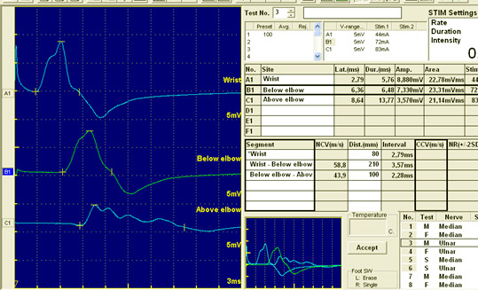
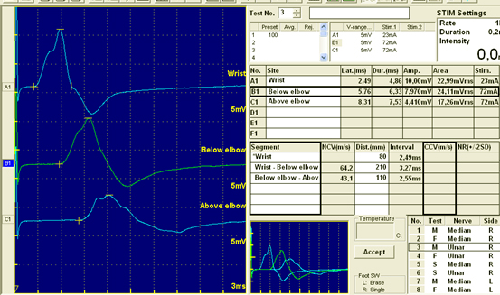
Immunossuppresants
Neuritis, T1 reaction in the right Ulnar treated with oral cyclosporine
Before: 3rd. potential with temporal dispersion above the elbow = segmental demyelination
After 2 months: TD significant reduction i the 3rd potential
GARBINO JA. Tratamento clínico da reações da hanseníase com repercussão neurológica - Revisão Histórica. Hansenol Int: Hanseníase e outras doenças infecciosas, 2012.

Slide 22
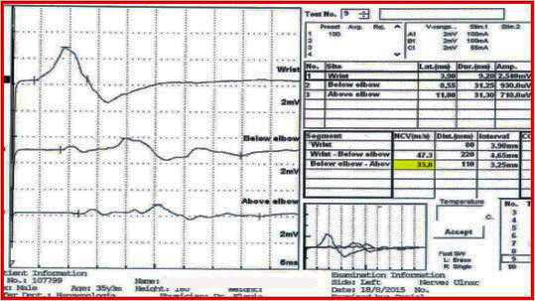
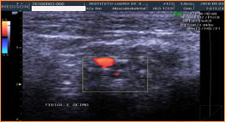
ADDING Ultrasound TO NCS
X
Inflammation is still restricted to the Schwann cells
MINIMAL,
MYELINIC AND AXONAL LESIONS
AKITA J, MILLER LHG, MELLO FMC, BARRETO JA, MOREIRA AL, SALGADO MH, KIRCHNER DR and GARBINO JA. Comparison between nerve conduction study and high-resolution ultrasonography with color doppler in type 1 and type 2 leprosy reactions. Clinical Neurophysiology Practice. 2021.

Slide 23
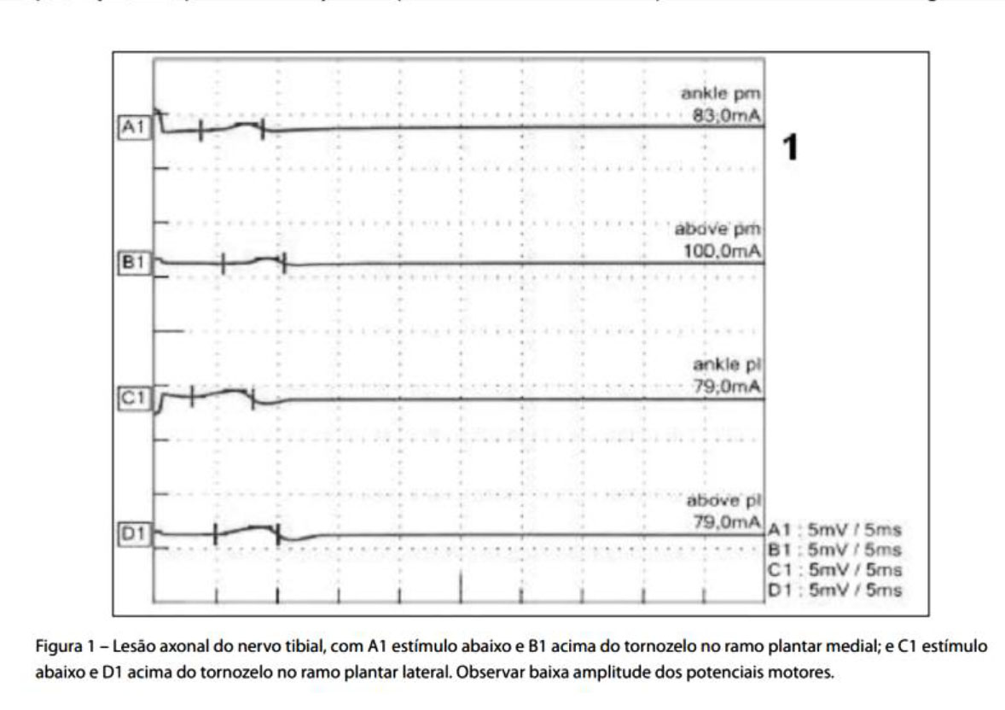
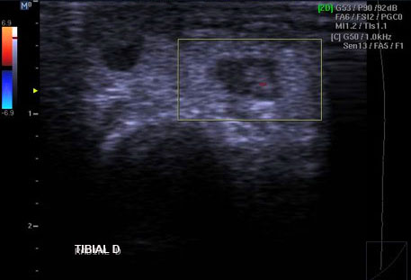
Advanced stage of nerve injury, axonal loss and fibrosis
Axonal pronounced lesion in motor nerve (or sensory nerve without response). There are still some reaction?
Areas of fibrosis and vascularization in one point (AKITA J et al.2021 )

Slide 24
The US with Collor Doppler can be useful in two conditions
In nerves with minimal (these Schwann cells presented the ML to macrofages earlier) and frank myelinic lesions (reactions T1 > T2)
In nerve with pronounced axonal lesion, very reduced or without motor response, (reactions T1 and T2)
“By adding the ultrasound assessment in these specific cases, neuritis was diagnosed in a greater proportion (68% with NCS jump to 85%) of the patients”
AKITA J et al. Clinical Neurophysiology Practice. 2021.

Slide 25
Follow up during disease progression
INFLAMMATORY – reactions (neuritis)
ENTRAPMENTS – post edema compression in the anatomical tunnels
NEUROPATHIC PAIN
To assess progression: serial evaluation

Slide 26
  Follow up with a Nerve Score of clinical data (SW, VMT and VAS) during immunossuppressant treatment (prednisone) of upper limbs nerves (months):
Normal response ↓
Prednisone curve
Normal response↓, but if the symptoms persist
= Neuropathic pain ? → DN4/LANS and pain questionaries
No response, despite of sufficient immunossuppressant doses 1mg/Kg= entrapment ?
GARBINO JA, HEISE CO, MARQUES WJr. Assessing nerves in leprosy. Clinics in Dermatology, 2015

Slide 27
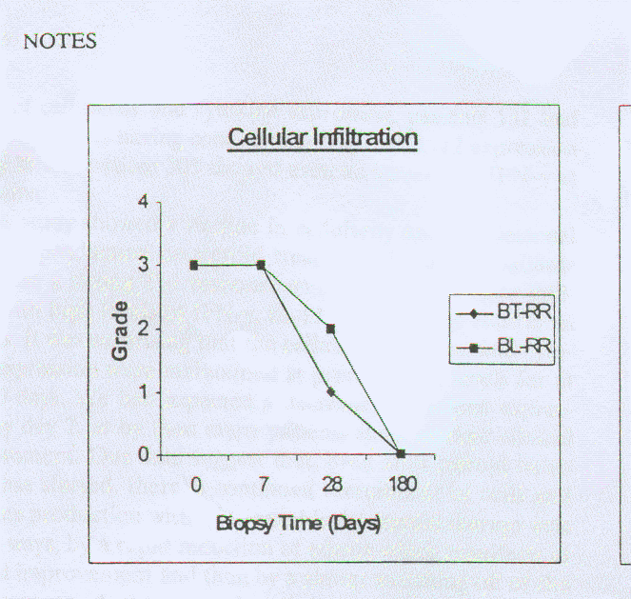
Type 1 reaction: skin cellularity, remyelination (TD) and Nerve Score CURVES during treatment are similar (6 months)
Skin inflammatory cells
Inflammation in Schwann cells
LITTLE ET AL. Cellularity,γ-INF, IL-12, iNOS in T1R under oral steroids, 2001
  GARBINO JA et al. A randomized clinical trial of oral steroids for ulnar neuropathy in type 1 and type 2 eactions. Arq. Neuro-psiquiatr. 2008

Slide 28
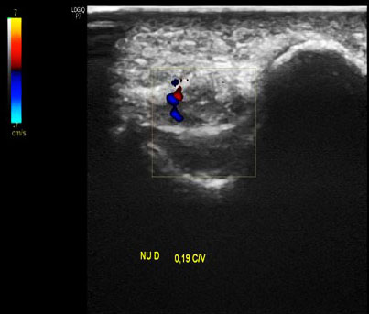
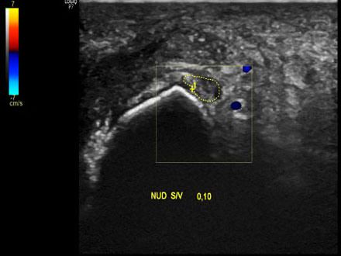
On US we can observe vascularization reduction intra and perineural with treatment
FOLLOW-UP USING COLLOR DOPPLER US

Slide 29
ENTRAPMENTS

Slide 30
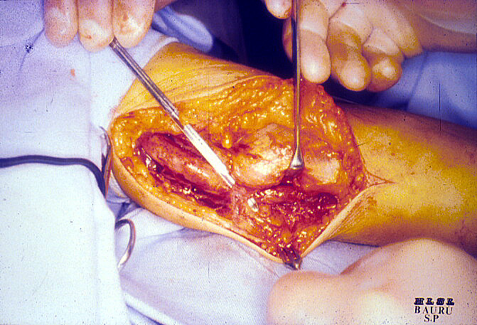
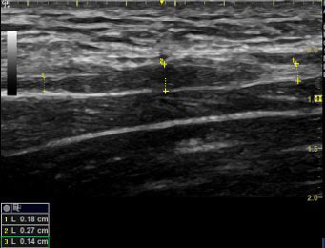
Fusiforme thickening above and bellow the compression site – peculiarity of compression syndromes
Epicondyle
Compression site at the elbow
Guyon
(MOREIRA AL, 2021; AKITA J et al.2021)

Slide 31
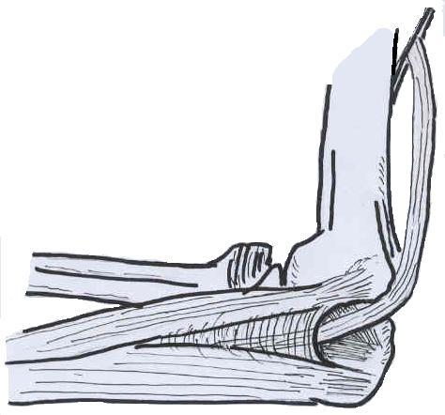
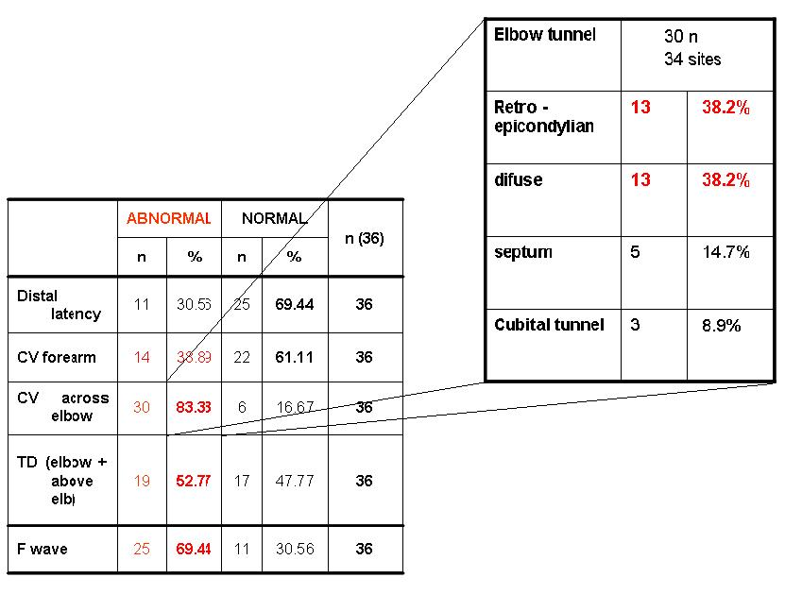
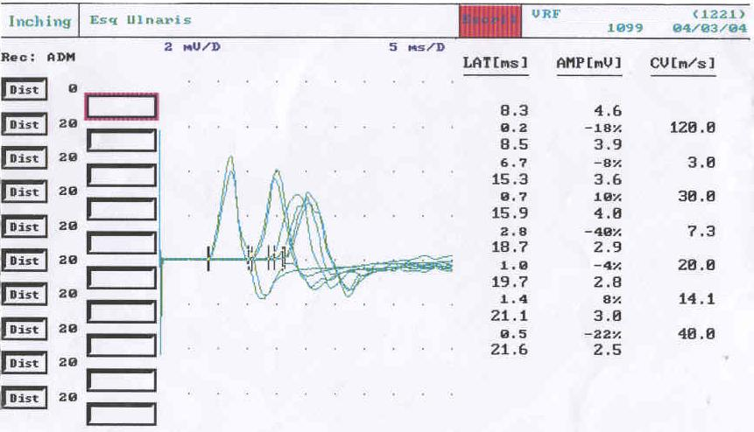
Leprosy as a model for entrapments
Septum
Epicondylus
retinaculum
↓
↓
INCHING
“Double crush” it does exist, the CMAPS are worsening progressively
GARBINO JA. Clinical Neurophysiology Approach To Leprosy Neuropathy. Leprosy Mailing List, April 2008

Slide 32
Decompression – neurolysis – Long term follow-up clinical x surgical treatment
CMAP wrist p= 0.38
CMAP bellow elbow p= 0.04
CMAP above elbow:
p= 0.05
TEMPORAL DISPERSION CURVE
CV in the forearm in surgical group: p= 0.027
(DT) TEMPORAL DISPERSION improving, no statistical significance (p= 0,08), reason = complications in progression
BORELA MCM, CURRY MFo, KIRCHNER DR, SALGADO MH, VIRMOND MCL and GARBINO JA. Neurophysiological comparative response to clinical and surgical treatment of the ulnar neuropathy in leprosy, Acta Fisiátrica (Journal of Physiatrics), 2020.

Slide 33
MAINTAINED TEMPORAL DISPERSION (TD) = DECOMPRESSION NOT SOLVED
TD FOLLOW-UP | SURGICAL GROUP n=13 | CLINICAL GROUP n= 12 | TOTAL
improvement | 7 | 4 | 11
estables | 4 | 6 | 10
worsened | 2 | 2 | 4
CAUSES OF REMAINING TD
  Ulnar nerve subluxation over the epicondyle (2 nerves)
  Reactions (2 nerves) BORELA et al, 2020

Slide 34
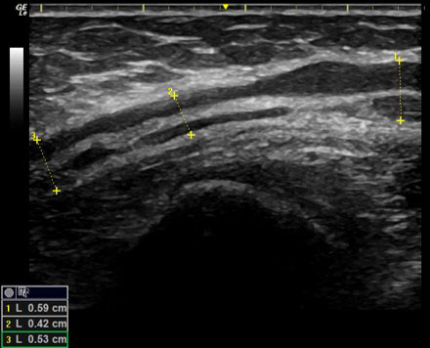
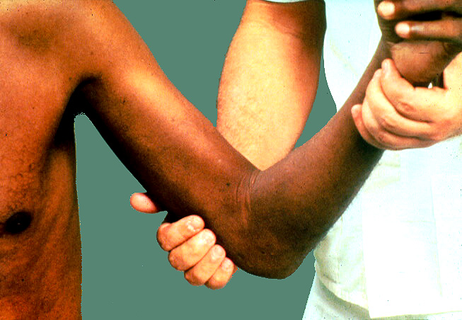
MAINTAINED TD = INVESTIGATION
Ulnar subluxation: nerve palpation
Reactions: clinic and lab + Doppler US
Post surgical scars: US
Scar hyperechoic area
Ulnar after neurolysis in the elbow tunnel (MOREIRA AL, 2021)

Slide 35
Nerve Histopathology
www.projetodiretrizes.org.br/.../hanseniase_neural_primaria
Prymary neural leprosy – systematic review – SciELO

Slide 36
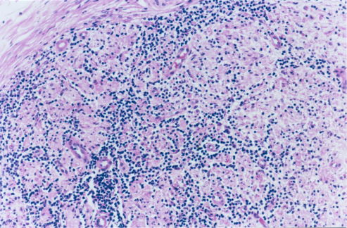
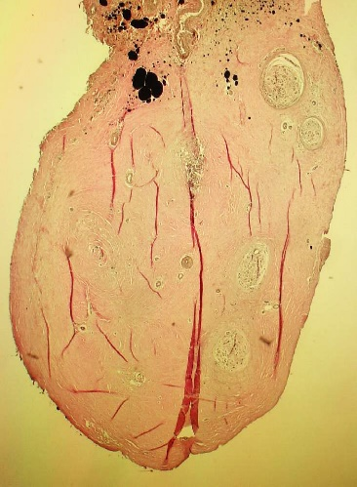
Patterns in PNL patients biopsies
Defined
Tuberculoid pattern
Borderline pattern
Multibacillary leprosy (BL)
Multibacillary leprosy and endoneural fibrosis
Probable PCR + → Defined
Unespecific inflammatory infiltrate endo and perineural
Unespecific inflammatory infiltrate and demyelination
Possible PCR + → Defined
demyelination and endoneural fibrosis
fibrosis endo and perineural
Only demyelination
PCR: protein chain reaction

Slide 37
Instituto de Pesquisas “Lauro de Souza Lima”
Bauru – São Paulo - Brasil
jgarbino@ilsl.br
or
ja.garbino@gmail.com

