Slide 1


ACNS Annual Meeting & Congress
Orlando Florida - 2024
Late responses: F wave, H reflex and A waves
In Peripheral neuropathies – beyond standard neurophysiological evaluation
JOINT SYMPOSIUM: US - BRAZIL
Garbino JA,MD,PhD
Instituto Lauro de Souza Lima, Bauru/ SP/ Brasil
Notes:
It is an honor to attend this US-Brazil Symposium at this FANTASTIC Meeting, my thanks to both Clinical Neurophysiology Societies.

Slide 2
No potential conflict of interest to be declared
Notes:
Before we start, I just would like to mention that there are no potental conflicts of interest to be declared.

Slide 3

Late responses are M-wave “satellites”
M-wave “satellites” obtained during modulated motor nerve conduction
  F-wave
  H reflex
  A-wave and axon reflex
Notes:
Late Latencies are “satellites” of M Waves: obtained during modulated motor conduction. In this presentation, I will talk about H reflex, F wave and A waves that are pathological findings

Slide 4
F(foot)- wave: originally described on the foot
(Magladery & Mc Dougal 1950)
The motor unit retrogradely activated via excitatory interneurons – Renshaw Cells (RCs) modulation – in anterior horn (Pinto 2023, Özyurt et al. 2023)
Distance travalled back and forth from the wrist or ankle to the anterior horn
Normal values in Upper limbs: 25-32 ms; Lower limbs: 45-56 ms
(Preston & Shapiro 2013)
Notes:
F waves are retrogradely activated mainly via interneurons, modulated by Renshaw Cells, in the anterior horn. A waves measure the round-trip distance from the wrist or ankle to the anterior horn of the spinal cord. Normal values varying accordingly to age and heigth

Slide 5
F-waves - features
Persistence: F wave number/ stimuli number (%)
Chronodispersion: duration between minimal and maximal latencies
Side to side comparison
  increased bilaterally: polineuropathy
  Unilaterally: radiculopathy, plexopathy, TOS
Velocity: distance C7-wrist: F – M – 1 ms (delay in anterior horn)/2
(delay in microcircuits activated by recurrent motor axon collaterals)
Notes:
The most common features used to evaluate F-waves are: First, persistence. This is measured by the percentage of F waves per stimuli number.
Second, chronodispersion, that is, the duration between the minimum and maximum latencies.
Third, side by side comparison. If latency increased bilaterally, we think in polyneuropathy and if increased unilaterally it could be mononeuropathy, radiculopathies or plexopathies
Fourth, … VELOCITY????

Slide 6
F-wave samples to measure
Nóbrega JA et al. Sample Size and the study of F waves. Muscle & Nerve, 1999
  calculated for the F waves after 5, 10, 16, 20, 32 and 64 stimuli, and for the first 5, 10, 16, 20, 32 F waves
  16 or 20 responses to determine minimum and maximum latencies, and 32 stimuli or 20 responses for chronodispersion.
  (sensitive marker in lumbosacral radiculopathies)
De Lima FD et al. F-wave persistence in peripheral sensory syndromes. Arq. Neuropsiquiatr. 2023
  20 supramaximal stimuli, filters at 2 Hz to 10 kHz, assessed the minimal and mean latencies and the persistence
Notes:
What is the ideal number of stimuli to obtain F Waves, this depends on the objective of the exam, what we are looking for: I brought two references about sampling standards to measure and study F-waves. In the first study, the authors studied a large variation in the number of stimuli (5 to 64) and the first F-waves recorded. This is a very robust study which defines 32 stimuli and 20 responses for accurate measures of chronodispersion. And, in the second study, de Lima and co-authors find that 20 stimuli are enough to evaluate the minimum and average latencies, and persistence.

Slide 7
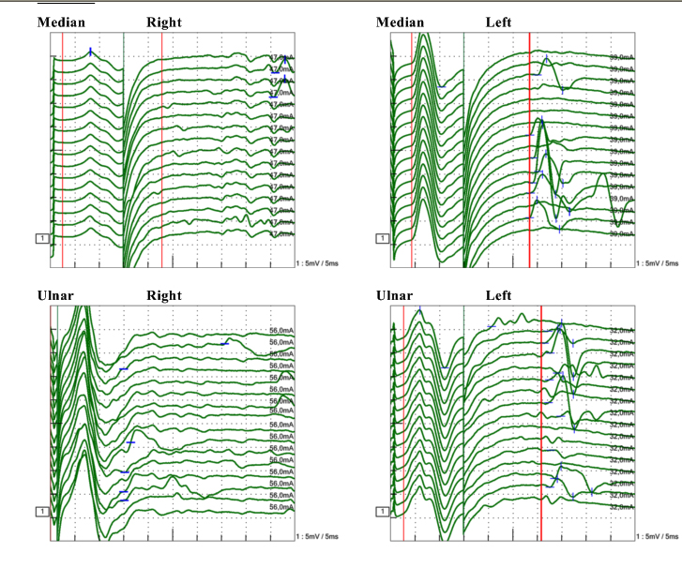
F-waves in the Upper limbs
F not detectable
F preserved and normals
Notes:
Here we can see extreme variation of F-waves: not detected on the right side, which could mean proximal conduction block, in inflammatory plexopaty, for exemple, and normal F –waves on the left.
The vertical red line would be the expected normal for age and height

Slide 8
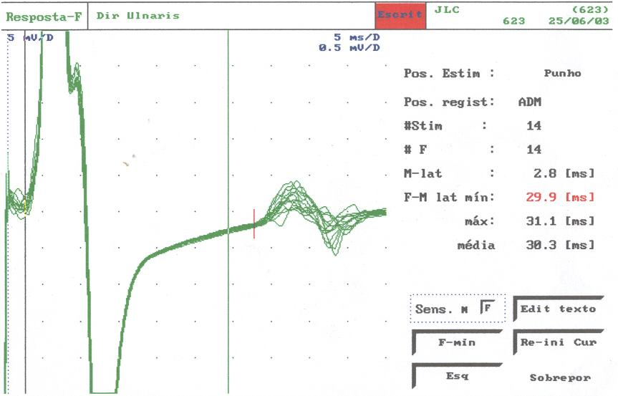
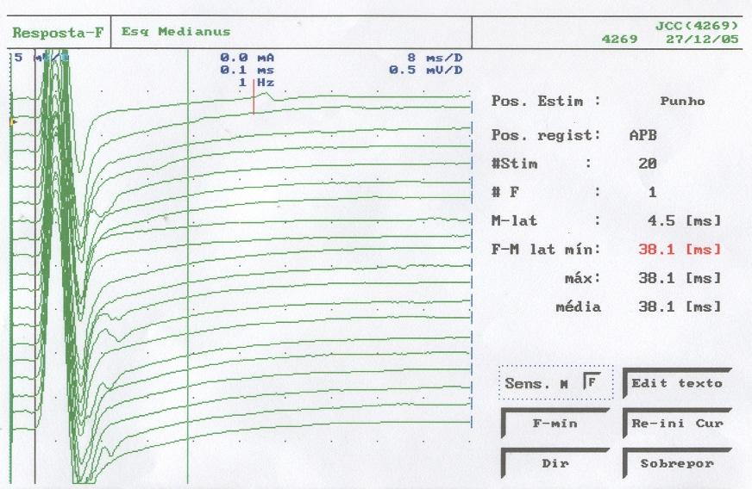
F-wave: increased latencies in both nerves but low persistence in the Median nerve
Several responses obtained: high persistence
Only one recorded response in 20 stimuli: very low persistence
Persistence: F wave number/ stimuli number
Notes:
Again other situations of abnormal F waves: F-waves with increased latencies and normal persistence in the right Ulnar and increased latency with low persistence in the right Median

Slide 9
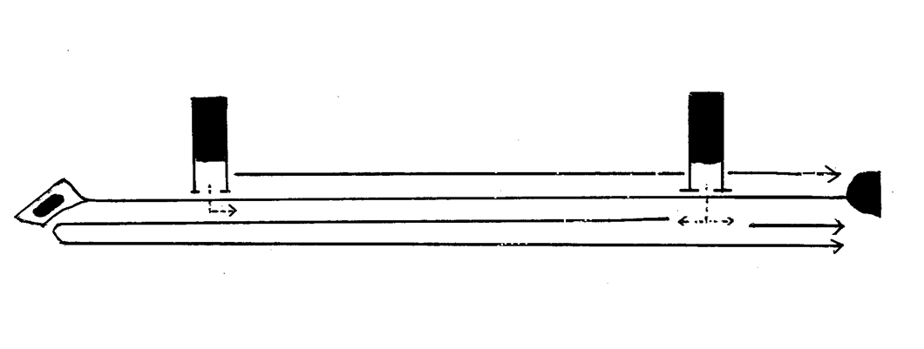
F-wave in thoracic outlet syndrome (TOS)
Axillary F-Loop Latency of Ulnar Nerve (AFLL)
DL
AL
F20
Latencies
F20 = AFLL: (F20 + Distal Latency)- 2 X Axillary L. = ms
Distal latency (DL) =
Axillary latency (AL)= (Normal = 9.2 + 0.8), variation (7,7 – 10.9)
(Hong l98l)
Notes:
How the F wave can help locate the site of compression or slowness:
A study published in the 80s, but interesting to evaluate thoracic outlet syndrome, AFLL, IN which, using the formula: (F20 + Distal Latency)- 2 X Axillary L) measures conduction through the thoracic outlet.

Slide 10
Atypical TOS suspicion
Young lady, 21 y, 150 cm
Hipoesthesia in the left hand, > 3 Years, loss of force and first space atrophy slightly progressive, without pain
Previus ENMG: Ulnar mononeuropathy, no focal involvement demonstrated, leprosy investigation negative
X ray cervical spine: normal, no cervical rib
MRI: within normal limits
(Garbino & Cury 2010)
Notes:
This case of suspected atypical TOS may illustrate its application

Slide 11
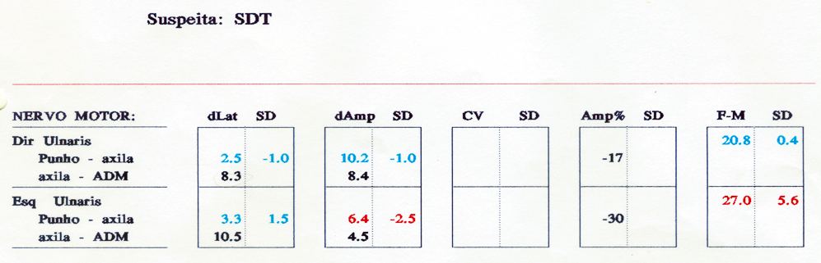
AFLL: atypical TOS suspicion
F-wave difference 6.2 ms
AFLL
L: 9.3 ms
R: 6.7 ms
Difference 2.6 ms
(Normal = 9.2 + 0.8), variation (7.7 – 10.9)
MRI normal: suspicion of Fibrous beam joining the transverse process of C7 with the 1st thoracic rib- Atypical TOS
  (Colli, In: Melo-Souza 2000)
Notes:
Let's observe the results
In this case we found out a side-by-side F-wave difference of 6.2 ms. A borderline Axillary F-Loop Latency of 9.3 ms and a side-to-side difference of 2.6 ms. These findings are indications of the the delay site, compression or slowness. With MRI normal it was a suspicion of Fibrous beam joining the transverse process of C7 with the 1st thoracic rib, Atypical TOS.

Slide 12
H reflex: Paul Hoffman, 1918
monosynaptic spine reflex: Circuit
  Ia muscle spindles sensory afferences → alpha motor neurons efferences
Reliable in Tibial nerve (popliteal) – soleus (S1) muscle
  With limitations in Median nerve - Flexor carpi radialis- and Femoral nerve – quadriceps-.
  (Preston & Shapiro 2020)
Widely present in newborn, persisting beyond 2 Years indicates upper neuron involvement
Notes:
The H-reflex is a monosynaptic spinal reflex described in 1918

Slide 13
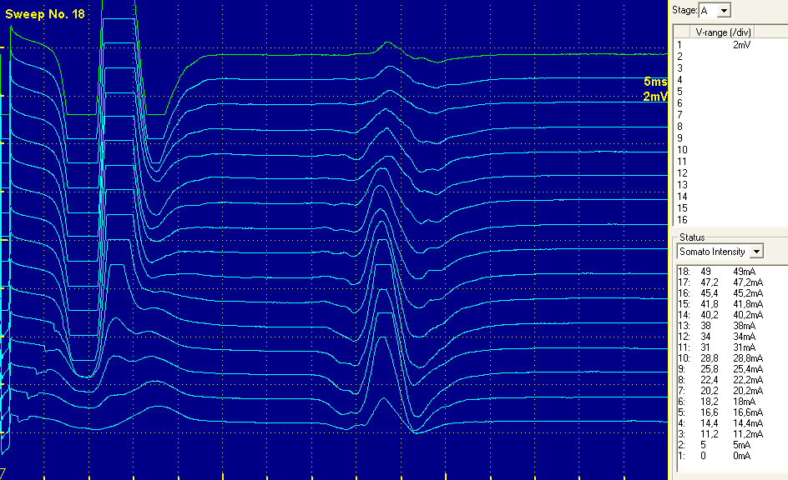
Normal H reflex
Stimuli series, submaximal to supramaximal in a normal patient
H-wave increasing and decreasing as the stimulus changes from submaximal to supramaximal
The H-wave amplitude decreases due to collision of potentials traveling antidromically with orthodromically H-wave
RATIO H/M ≤ 50%

Slide 14
Applications
Zhu et al. Proximally evoked soleus H-reflex to S1 nerve root stimulation in sensory neuronopathies (ganglionopathies). Muscle & Nerve, 2013
  Tibial and S1 foramen H-reflexes were absent bilaterally in all patients with SNN (n= 11)
Fracp et al. Neurophysiological evidence for generalized sensory neuronopathy in cerebellar ataxia with neuropathy and bilateral vestibular areflexia Syndrome. Muscle & Nerve, 2015 (CANVAS)
  Tibial H-reflexes were absent in 11 of 14 patients.
Sachs GL and Logigian EL. Proximally evoked soleus H reflexes in the evaluation of axonal neuropathy. Journal of the Neurological Sciences, 1996.
  absence of soleus H reflexes evoked by proximal sciatic nerve stimulation at the gluteal fold.
Notes:
Some applications of the H reflex, beyond S1 radiculopathy, in a look at the literature

Slide 15
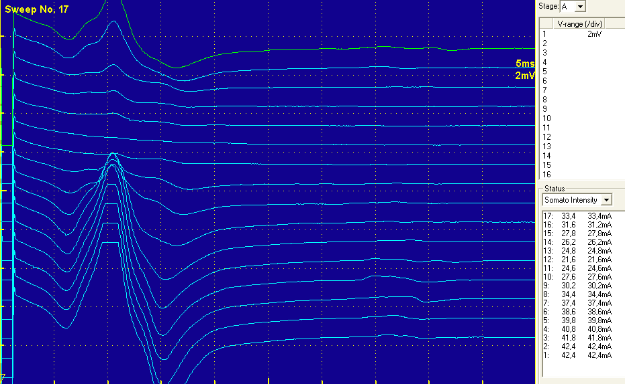
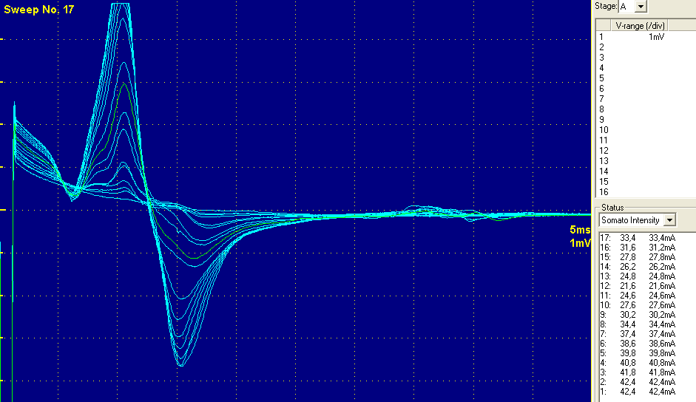
Abnormal H reflex: Female, 48 y, tetraparesis 2 months, treated with Ig IV, keeping tetraparesis improving (AIDP)
H-wave with very low amplitude in all stimuli series (F-wave?): Proximal Conduction Block: sensory or motor, or both
Conduction Block seeing by superposition.
Notes:
One case of AIDP showing Conduction Block

Slide 16
Late Responses – aquisition F & H summary
F-wave | H-reflex
AFFERENT Motor | Sensory (Ia muscle spindle)
EFFERENT Motor | Motor
SYNAPSE mediate by RCs | Yes (monosynaptic)
NERVES STUDIED All | Tibial-soleus (median-FCR, femoral-quads)
STIMULATION Supramaximal | Submaximal, long duration pulse (1 ms)
Notes:
Now we have a table with a summary of both latencies
Most important to emphasize is that Submaximal and long-lasting pulse, 1 ms, has the specificity to stimulate Ia sensory fibers

Slide 17
Pathological findings
A wave and Axonal Reflex
Notes:
These late latencies, A-wave and Axon Reflex, are always associated with nerve pathology

Slide 18
A-wave – features
A –wave and Axonal motor reflex are ephaptic activations of peripheral nerve fibers and it is not a true reflex
A-wave are stable morphology potentials and initial latencies varying less than 1.5 ms
A-wave recording can be in between M and F waves, after F and it can be multiple
There is findings associated to nerve fiber pathology, myelin or axon
  (Bischoff et al. 1996; Dumitru et al. 2002; Preston & Shapiro 2013)
These studies and reports demonstrate clinical application in inflammatory neuropathy (Kornhuber et al. 1999; Garbino et al. 2011; Badry 2019)
Notes:
Both the A-Wave and Axonal Reflex are ephaptic activations.
Both present stable morphology, with little variation in shape and latency.
They can occur between M and F, after F and can be multiple.
They are, since the 90s, associated with nerve fiber pathology.
Recently more work are relating it to the clinical aspects.

Slide 19
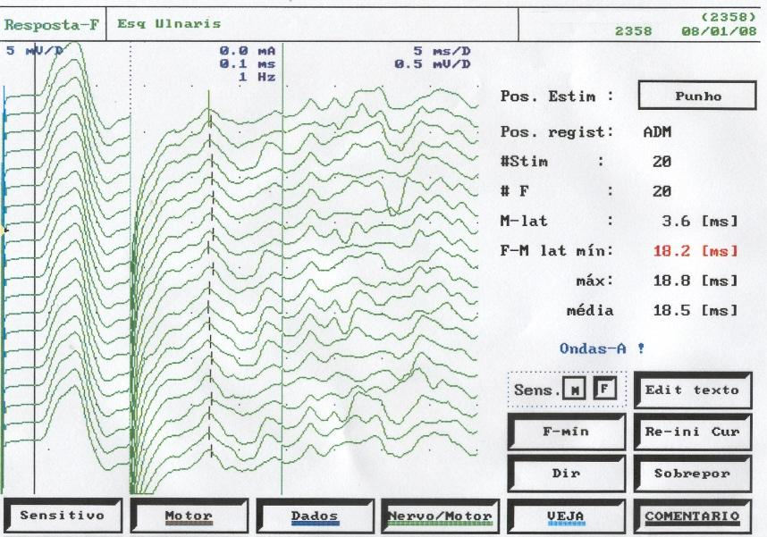
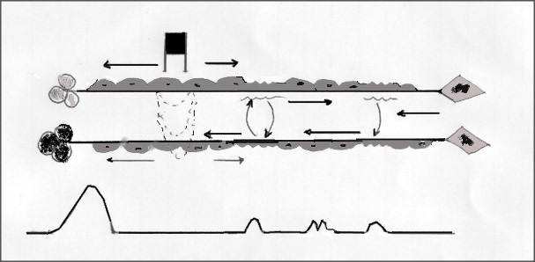
Pathophysiology 1
↓
↓
Pace-makers
↓
M
A
F
A
Multiple A-waves meaning: multiple sites of focal demyelination or collateral axonal sprouting, or reverberances at one same pacemaker, similar to CRD in EMG
Notes:
Why do multiple A-waves occur? It can be because several sites of demyelination or axonal sprouting along the nerve (pacemakers). Or even, reverberations of these pacemakers in the same place

Slide 20
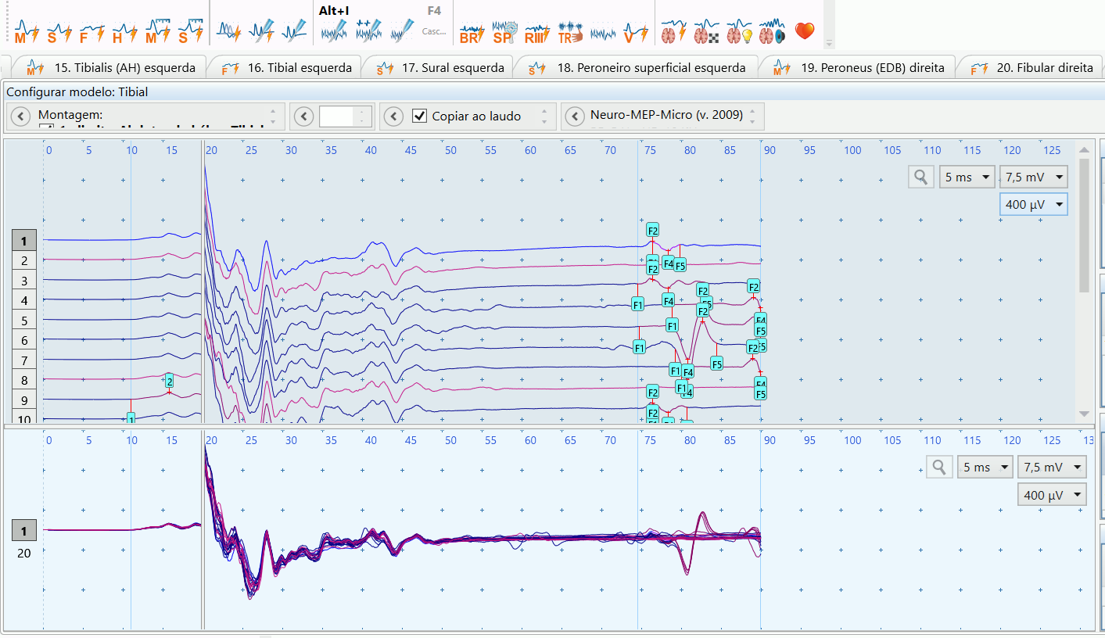
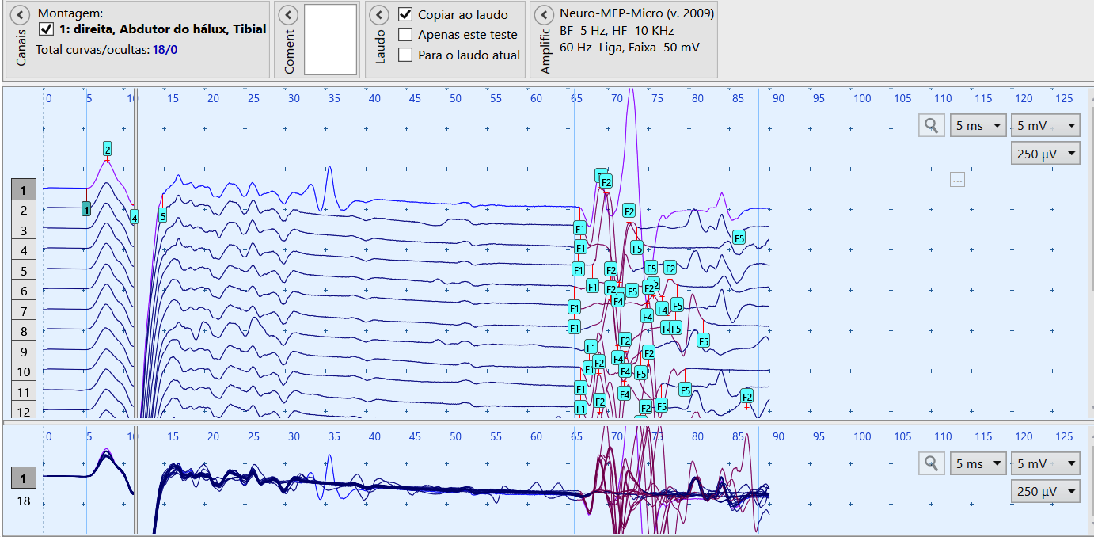
Pathophysiology 2:
Multiple A- waves multiple and grouped
CIDP: male, 61 y, first examination with full criteria for CIDP
Chronicle Back pain in lumbar spinal stenosis: male, 63 y
Notes:
Another situation:
Multiple and grouped A-waves in CIDP and in a patient with chronic low back pain in Lumbar spinal stenosis, showing that A-wave is a transetiological phenomenon

Slide 21
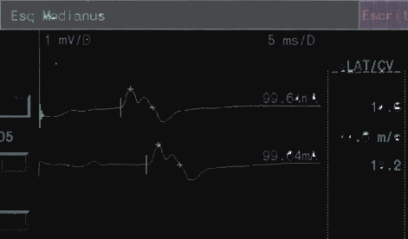
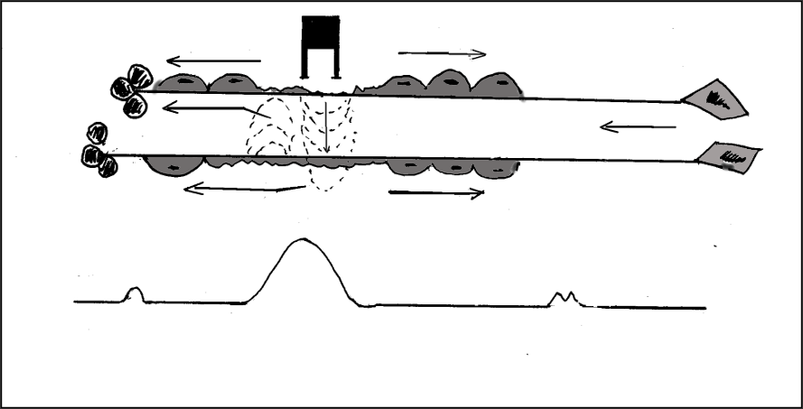
Pathophysiology 3: is “pre-motor” potential actually an A-wave?
Speculations: Sensory potential? Motor? A- wave before motor potential is plausible?
S
R
Median nerve motor CS in a pronounced STC, DL: 14.6 ms: pre- motor potential presente in both sites of stimulation
Pacemakers between the stimulus and M-wave
Notes:
There is no description in literature about A-wave before M-wave
Could the A- wave appear before the M-wave, could it be an early latency? Some have already observed this occurrence and even speculated that it could be a sensitive potential. We have observed in pronounced TCS, in wich sensory potential before the motor would be impossible. Extensive demyelination in the carpal tunnel could form pacemakers distal to the stimulus site and consequently A- waves can be observed.

Slide 22
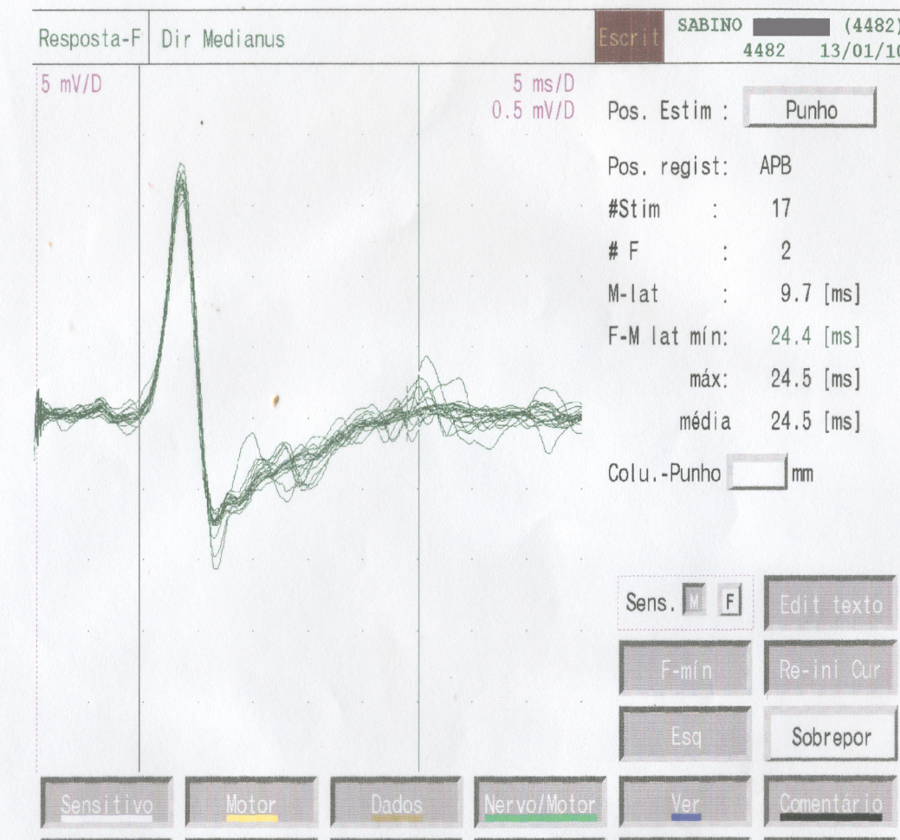
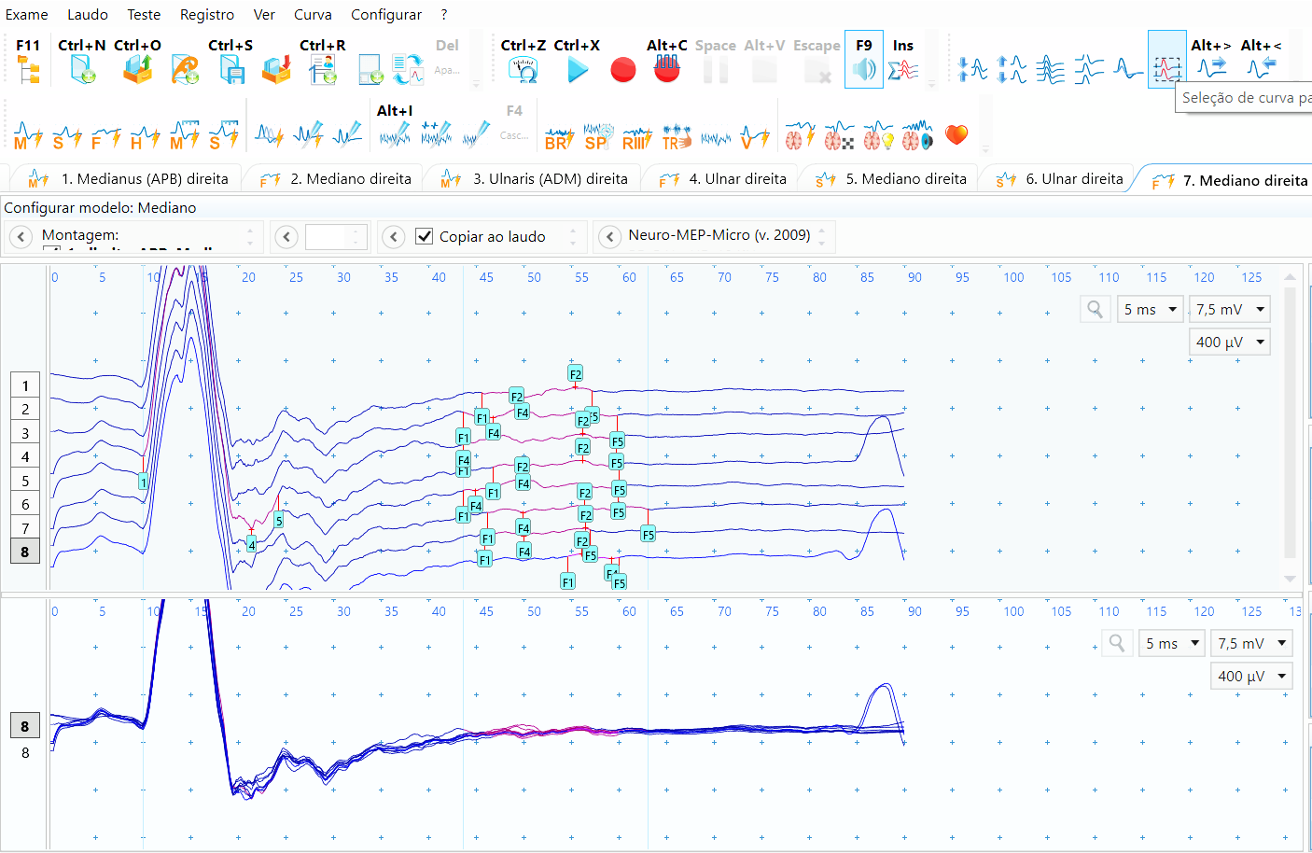
Pre-motor potential is actually A-wave
↑
↑
↑
↑
Stable morphology potentials and initial latencies varying less than 1.5 ms, obtained during F-wave procedure, by supramaximal stimuli, M-wave “satellites”
Both nerves with pronounced and painfull TCSs
Notes:
Examples of pre-motor A-wave in pronounced TCSs: stable morphology and initial latencies, obtained during F-wave procedures, acttualy M-wave satellites

Slide 23
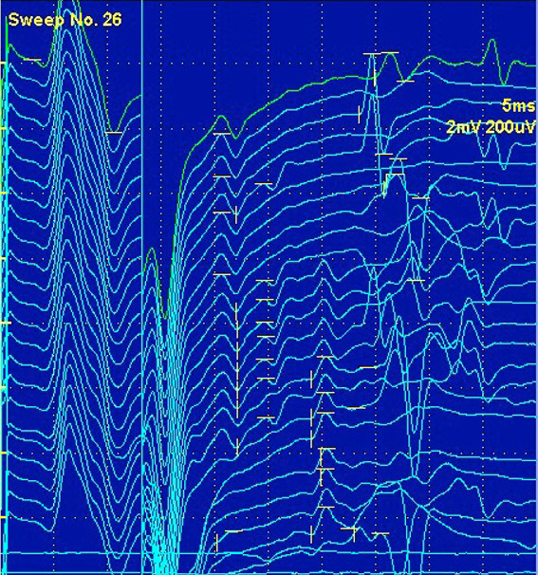
Axonal reflex: main feature
It starts with submaximal stimulus and is abolished as the stimulus is increased.
It´s also related to pain in leprosy patients.
(Garbino, Kirchner & França 2022)
Notes:
Axonal reflex a modality of A-wave:
The Axonal Reflex has a similarity to the H Reflex, which is why it was initially called “reflex”. That is, it appears with submaximal stimuli and disappears as its intensity increases. As we can see here in this figure.

Slide 24
Insights on A-wave clinical meaning on pain in leprosy -1 epidemiology
Stump PRNAG & Baccarelli R et all. Neuropathic pain in leprosy patients. International journal of leprosy and other mycobacterial diseases. 2004/2
N= 358 patients with leprosy in Instituto Lauro de Souza Lima from 2001 to 2002
201 patients reported pain
  148 (73.6%) reported episodes of pain only in the past, reactions – neuritis?
  53 (26.4%) with pain present at the time of interview,
  34 (64.2%) continuous and 19 (35.8%) is episodic, reactions?
Notes:
This study is a landmark on leprosy pain epidemiology, until then, loss of sensitivity was the main known sensory symptom. Due to the importance of this study, we began to look at pain in leprosy and how neurophysiology could help to understand this phenomenon. The episodic pain drew our attention to signs of hyperexcitability in the nerve. At, first, we thought intuitively about paroxysmal pain and that these ephases (A-wave and Axonal reflex) could be underlying these symptoms

Slide 25
Insights on A-wave clinical meaning on pain- 2
A picture of hyperexcitability (A-wave) involving all fibers, as well as the sensory fibers, were demonstrated
  (Montserrat et al. 1990)
Relatioship between A-wave abolishement and pain reduction (VAS visual analogic scale) in leprosy reactions, inflammatory neuropathy, after treatment
  (Garbino et al. 2011)
Relatioship between A-wave and neuropathic pain (DN4,Douleur neuropathique 4 questionaire), in post-inflammatory neuropathy
  (Garbino, Kirchner & França 2023)
Notes:
Montserrat AND COLLEGUES : “57 of 60 nerves (29 median and 31 ulnar) sutured at the wrist, forearm and arm, they recorded motor responses in thenar or hypothenar muscles by electrical stimulation of the corresponding fingers, and recorded A-waves.

Slide 26
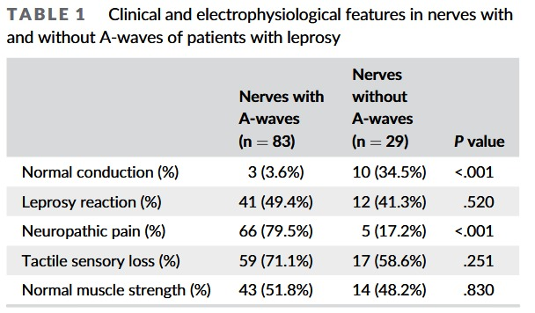
A-waves are associated with neuropathic pain in leprosy
(Douleur neuropathique 4, DN4 - questionaire)
Bouhassira D et all, Pain, 2005
Garbino JA, Kirchner DR, França MC Jr. A-waves are associated with neuropathic pain in leprosy. Muscle & Nerve. 2023;1‐4.
Paroxysms in 58% of nerves in DN4
Notes:
As we see here in this table, a strong correlation between neuropathic pain defined by the Douleur neuropathique 4, DN4 – questionaire and A-wave, in chronic neuropathy without inflammation! And also in these 58% of the nerves the presence of painful paroxysms identified by the questionnaire DN4 adopted by Brazilian Society for the Study of Pain

Slide 27
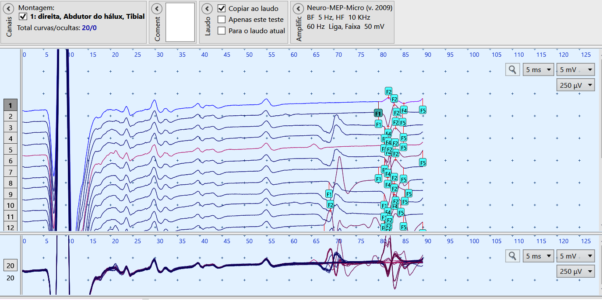
Future: study A-wave under pain treatment
Chronic Back pain/ lumbar spinal stenosis: male, 63 y, 4 months of treatment (amt + clorpromazine), without complaints at the moment
02-06-2023
13-10-2023
Observing the A-wave behavior it looks like an ungrouping of the grouped A-waves. Reducing of A-wave reverberances could cause pain reduction?
Notes:
These observations open new perspectives for studies in other causes of neuropathic pain on the behavior of A-waves and it´s behavior under clinical treatment.

Slide 28
Thank you!
www.ilsl.br
jgarbino@ilsl.br
www.climedbauru.com
ja.garbino@gmail.com

